Slide 1
Electric Vision
Ken Sutter – skenneth@pdx.edu
Phil Nevins - pnevins@pdx.edu

Slide 2
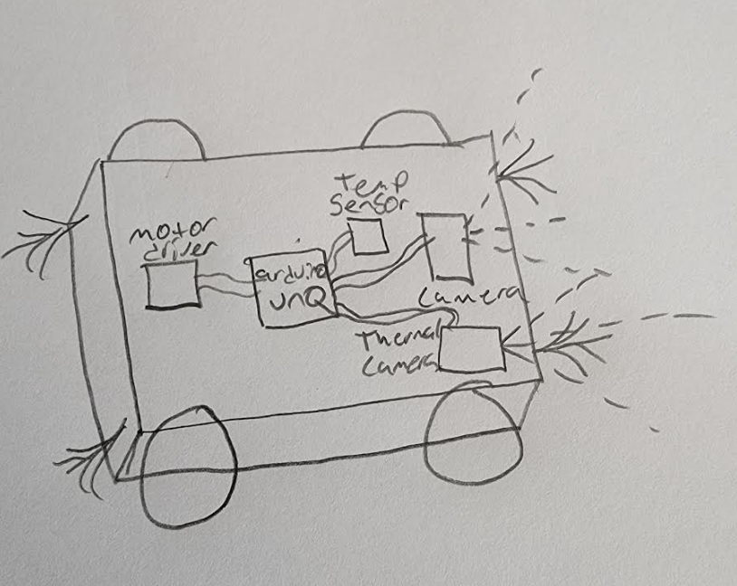
Team Project Design: EVbot
We chose to create a robot to help firefighters in the field. It can help with search and rescue, confined spaces, and finding active fire.
The EVbot’s capability's include:
Temperature and Humidity sensing
Wi-Fi video feed
Wi-Fi controls
Wi-Fi Adjustable pan and tilt arm
Lights
Tracks with suspension
Battery powered

Slide 3
Component list:
Robot tank frame
Pan and tilt arm assumably
2x ESP32
ESP 32 cam
Standard 9V battery
2x 9.6V batteries rechargeable 2100 mAh
Rechargeable USB battery block 10000 mAh
L298N motor driver board
Arduino power module
DHT11 temperature and humidity sensor
Phone/laptop/Wi-Fi device
8x White LEDS
Switch
Breadboard
Resistors
Wires and jumper wires
USB Cable
Various bolts, nuts, spacers, and washers

Slide 4
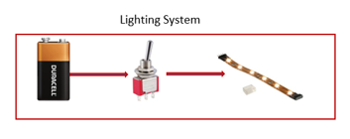
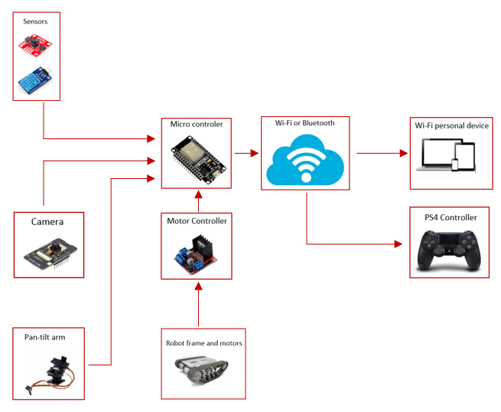
Initial Project Design
Wi-Fi or Bluetooth connectivity.
PS4 controller to drive robot and control camera arm.
Sensors, camera, motors, and camera arm all run through the microcontroller.
Personal device to view sensor reading and camera display.
Standalone analog lighting system.

Slide 5
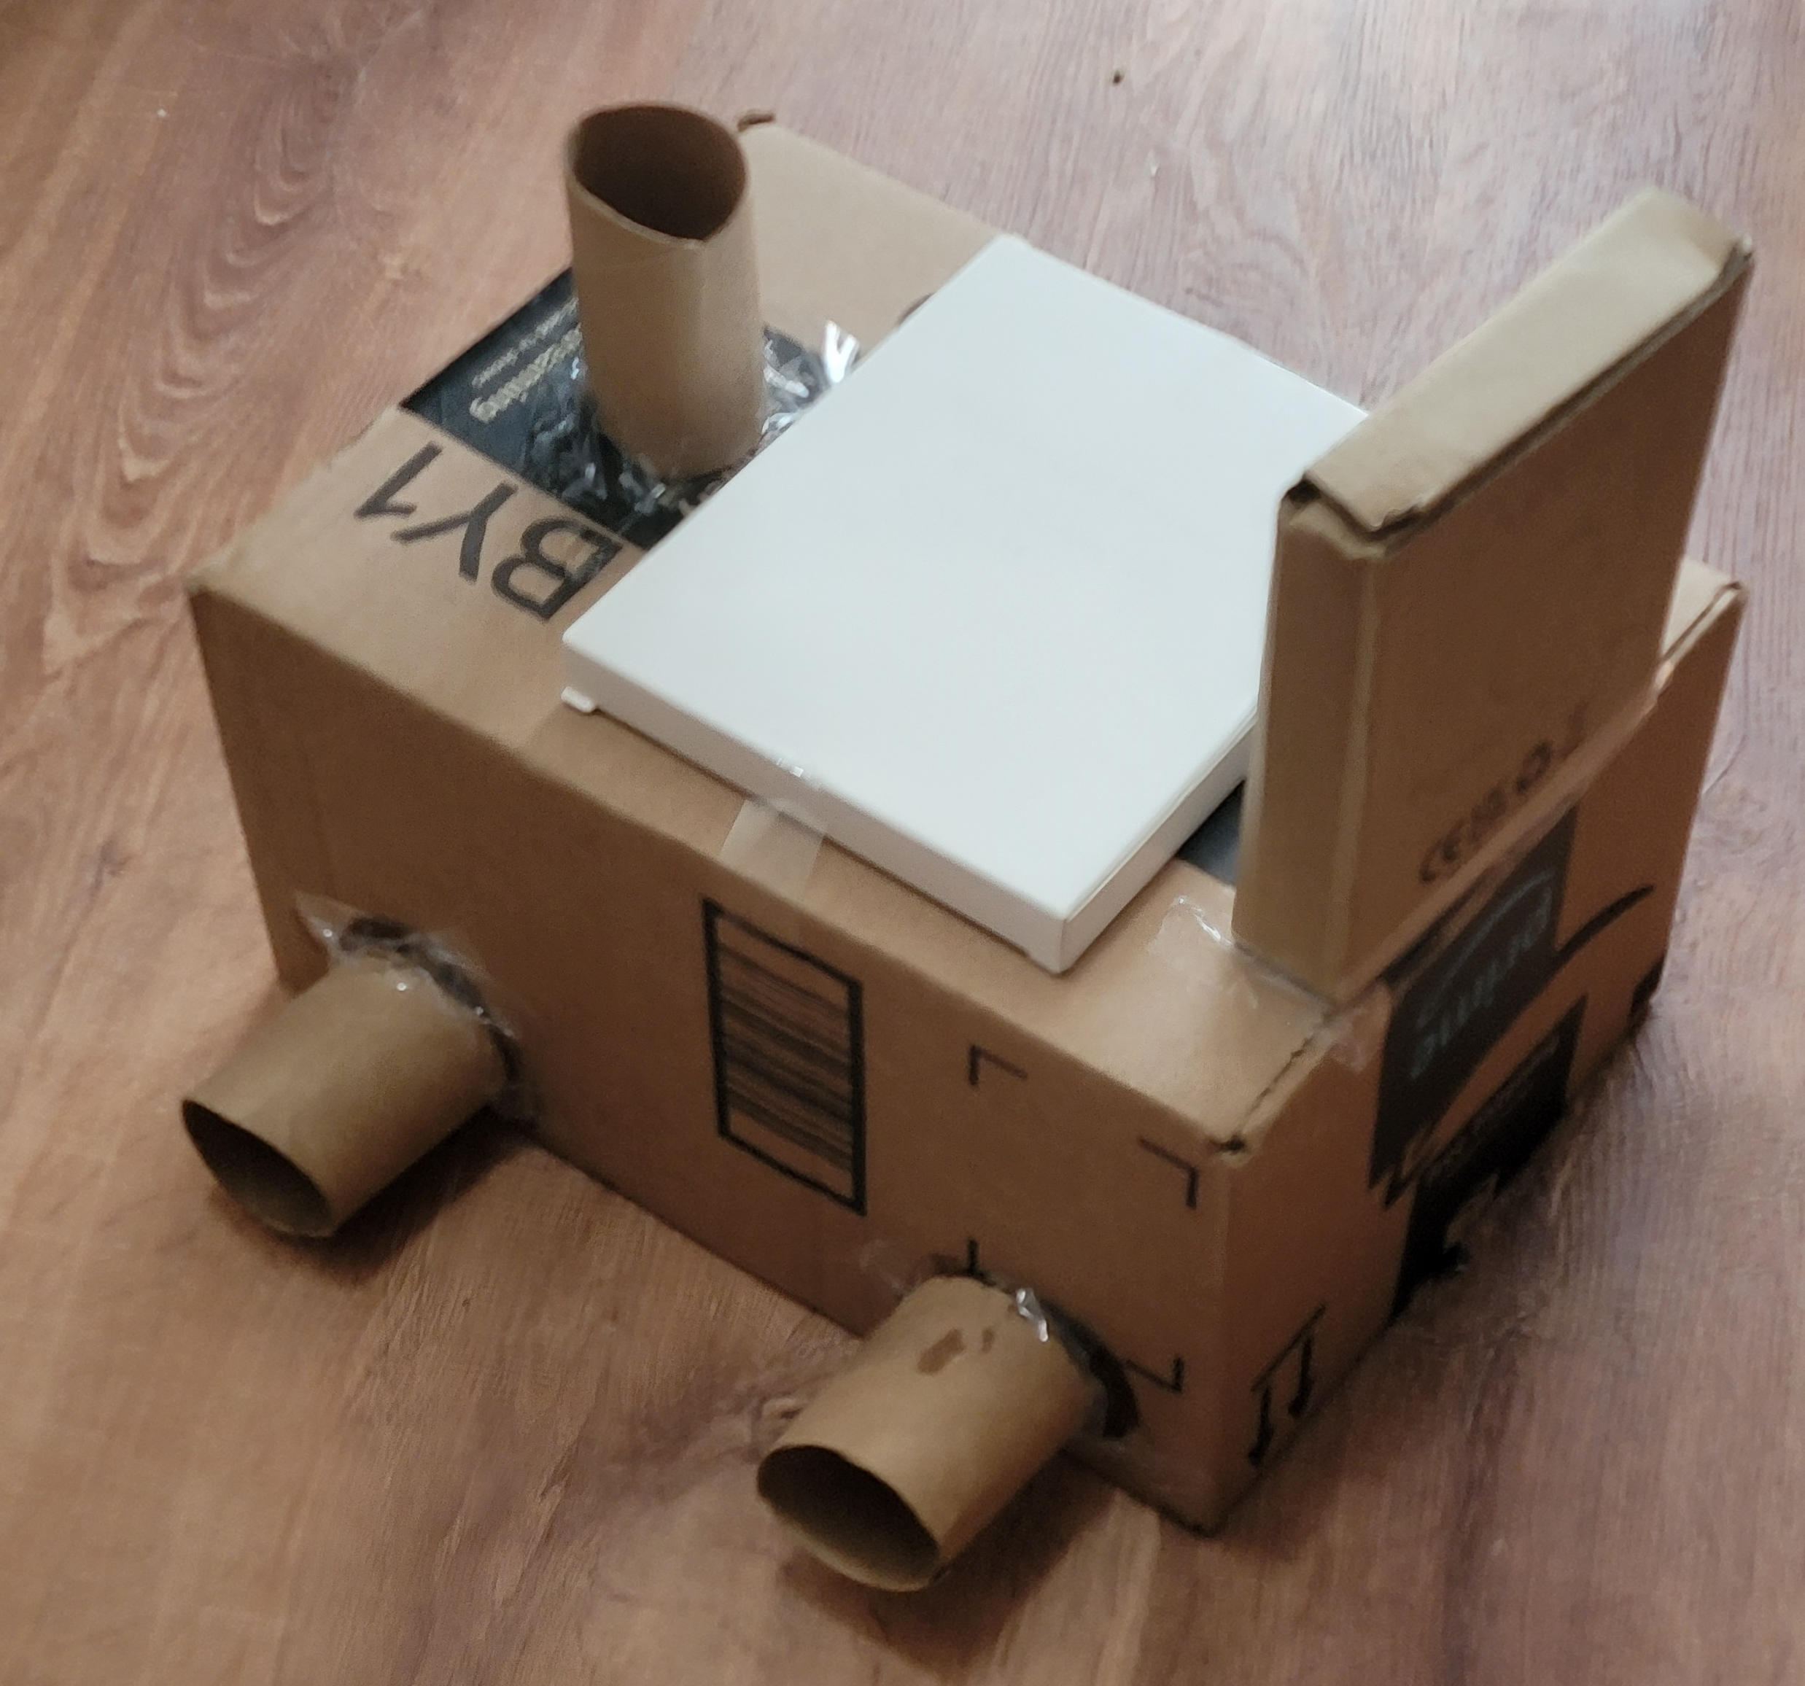
First Project Prototype
Quick and simple prototype.
Cardboard prototype.
Helped to visualize the final project layout.
Helped us visualize scale.
We were able to place subsystems on this while waiting for frame.

Slide 6
Subsystems
Waiting on various parts.
Split the project into subsystems:
Lighting
Thermal sensor
Temperature and humidity sensor
Frame
Robot control
Camera
Created and tested each subsystem in various prototyping phases. We then added each subsystem to the frame and tested incrementally.

Slide 7
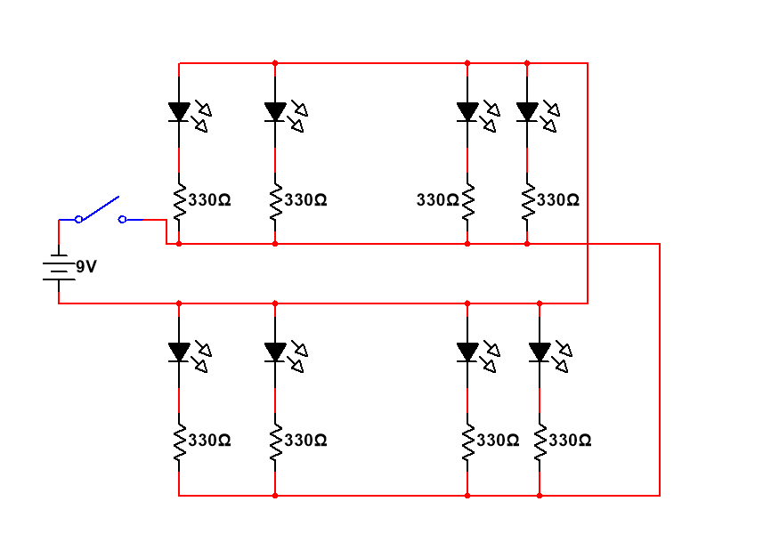
Lighting
Started with the idea of ARGB LED light strips.
Realized it would be much cheaper and just as effective to wire LEDs and resistors to a battery and switch.
First iteration was just bare wires taped to LEDs and resistors (burnt some LEDs).
Second iterations we added the 9v battery.
Third iteration we added the switch and properly soldered and covers all of the connections.

Slide 8
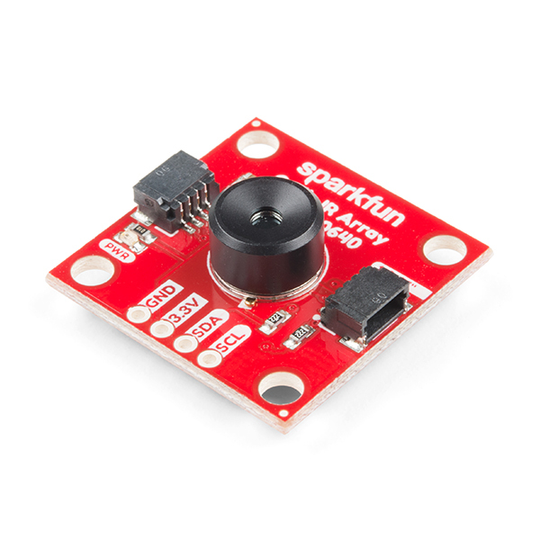
Thermal Sensor
MLX94640 sensor on Sparkfun breakout board.
I2C would not connect.
Spent 2 weeks when it arrived troubleshooting.
Shorts are a common problem with this board.
Decided to get an replacement.
Replacement did not arrive in time for project.
Decided to push this subsystem to future tasks.

Slide 9
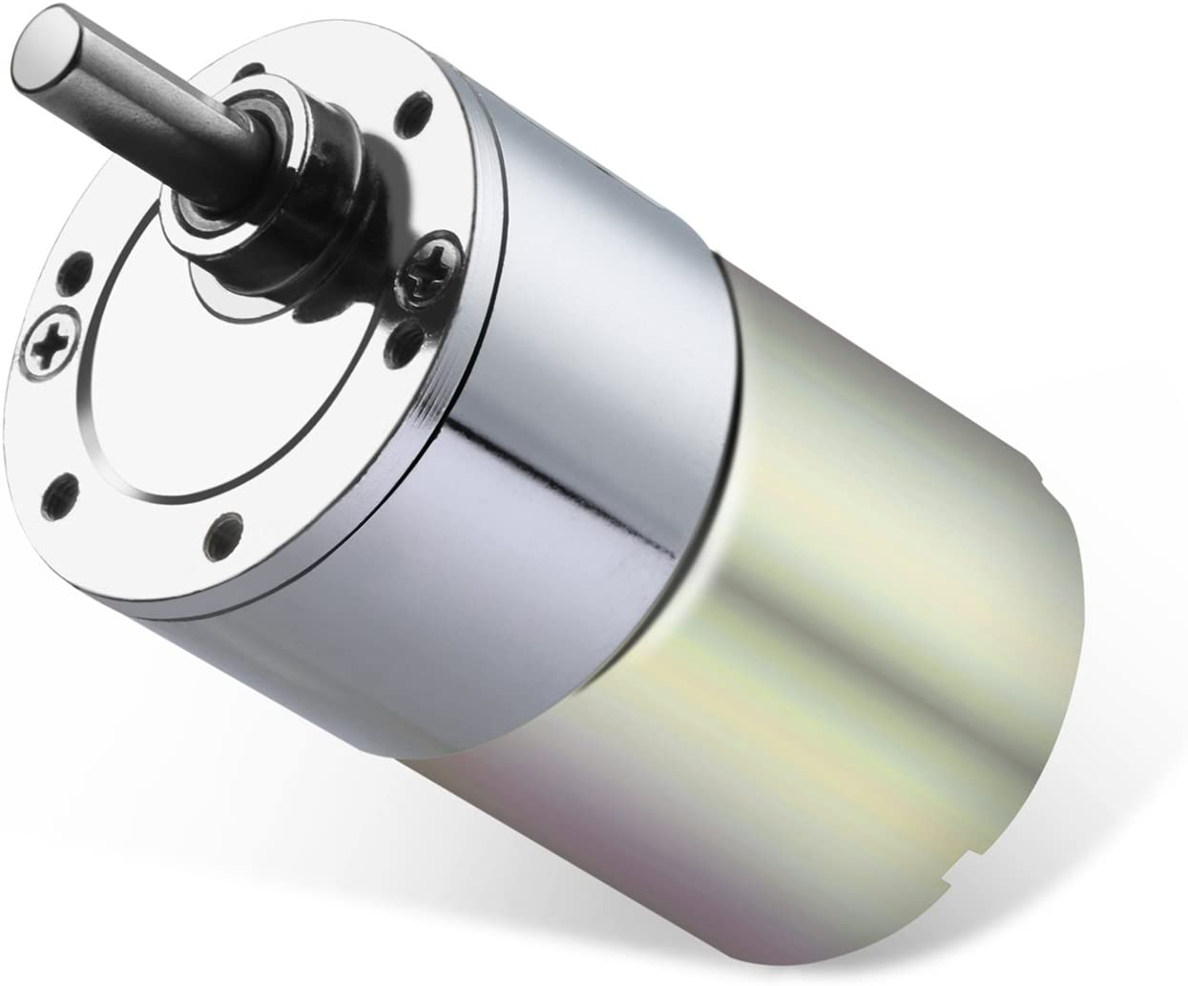
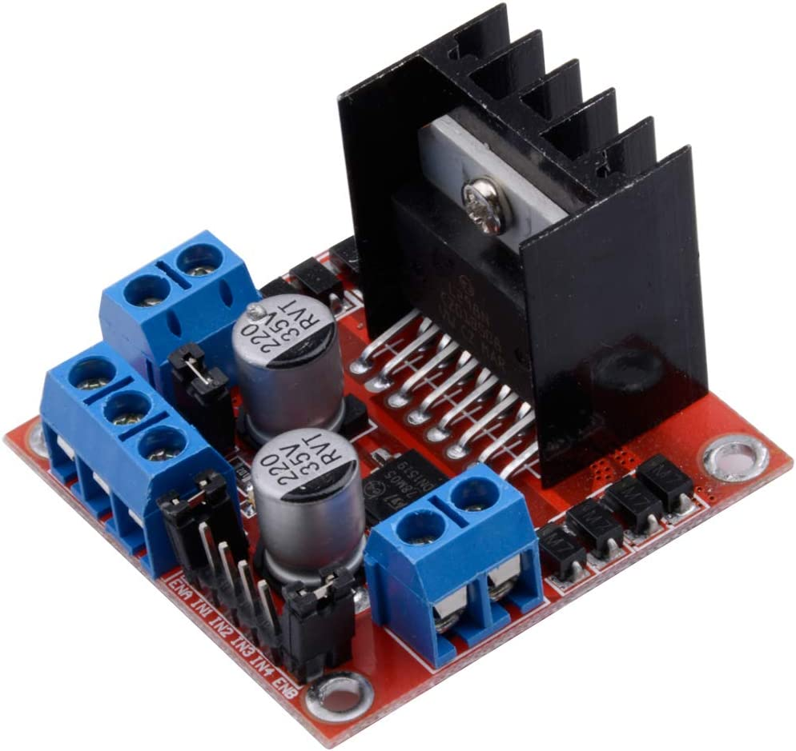
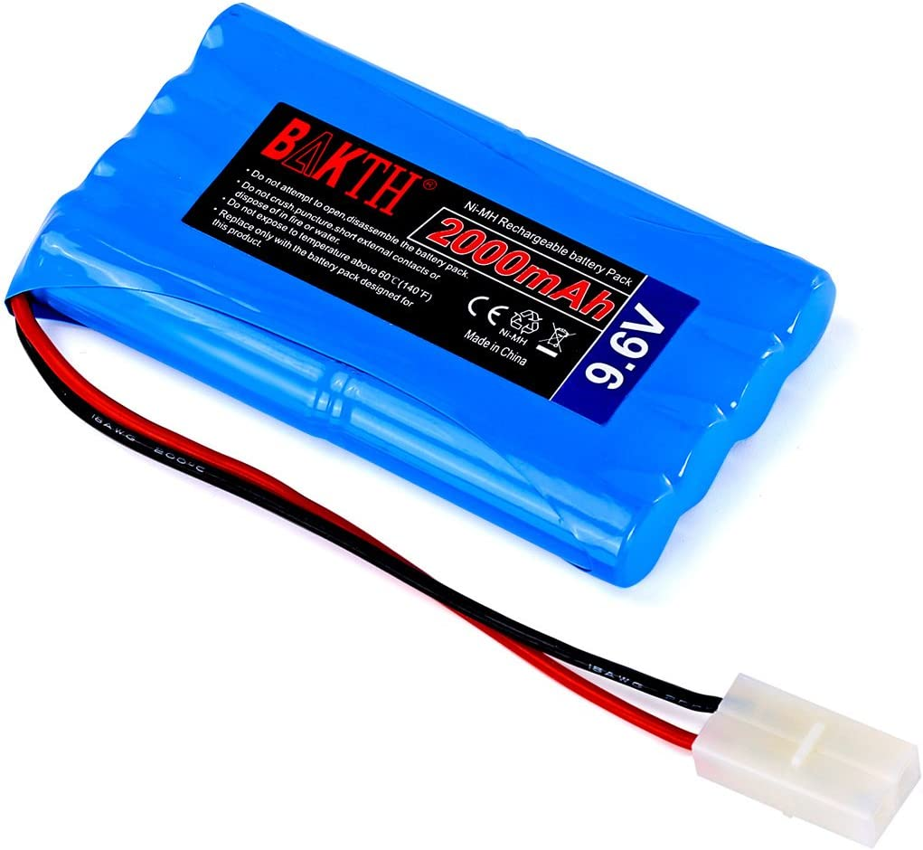
Robot Control
First iteration was just taping the positive and negative wires to a 9V battery
Second iteration was using a Arduino UNO with the L298N motor driver board
Third iteration was with ESP32 and the L298N motor driver board
Fourth iteration we implemented battery power system so it would be wireless

Slide 10
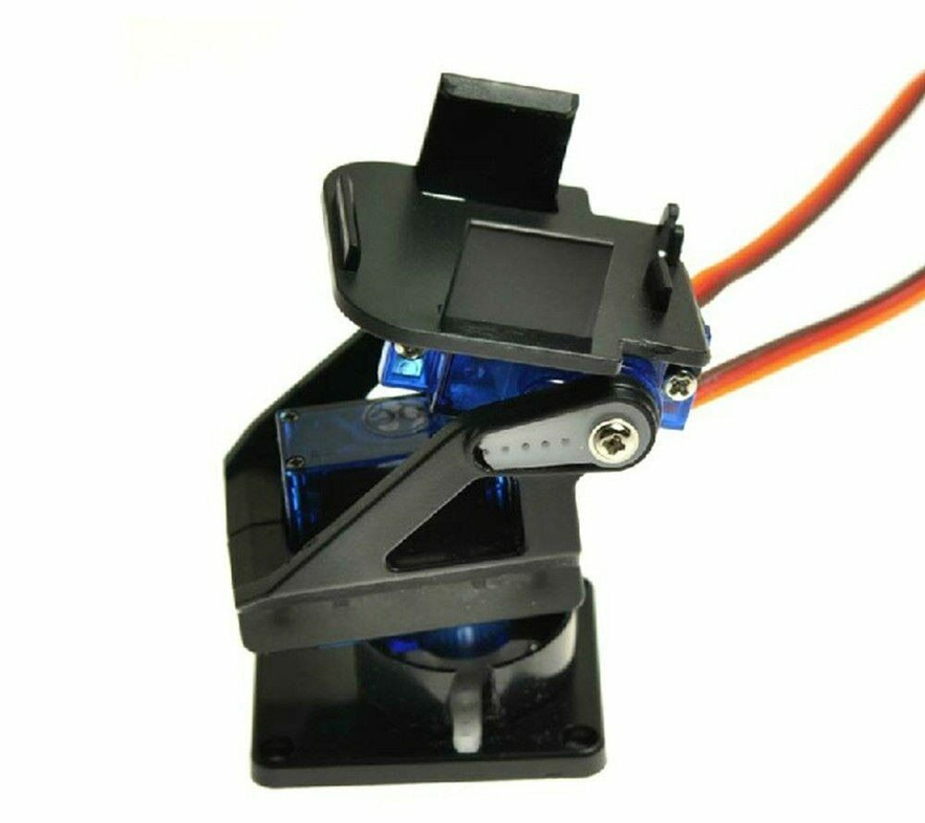
Pan-Tilt Arm
Needed to move the camera to get various camera angles.
First iteration we taped the camera sensor to the frame.
Second iteration we tried to design a mechanical mechanism to move the camera.
Third iteration we found the pan-tilt arm and super glues the sensor to the assembly.

Slide 11
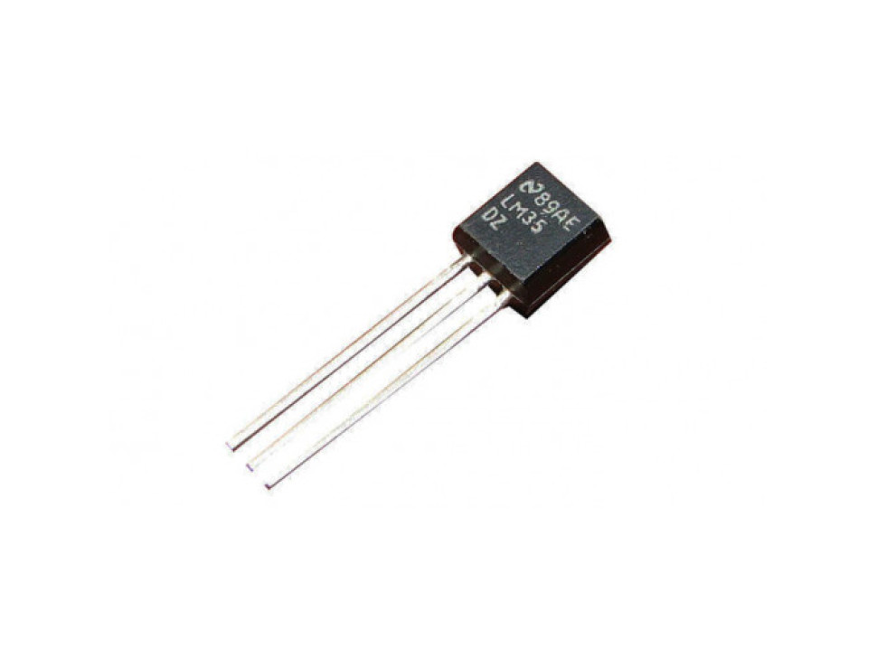
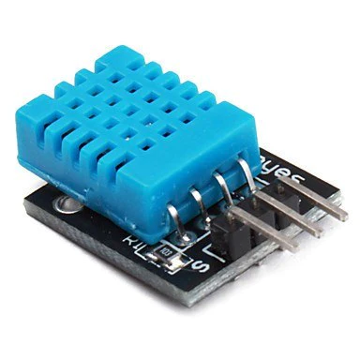
Temperature and Humidity Sensor
First iteration we used the LM35 with Arduino UNO.
Second iteration we moved to using ESP-32 with LM35.
Final iteration is ESP32 and DTH11 sensor. This allowed us to be fully wireless and have accurate temperature readings.

Slide 12
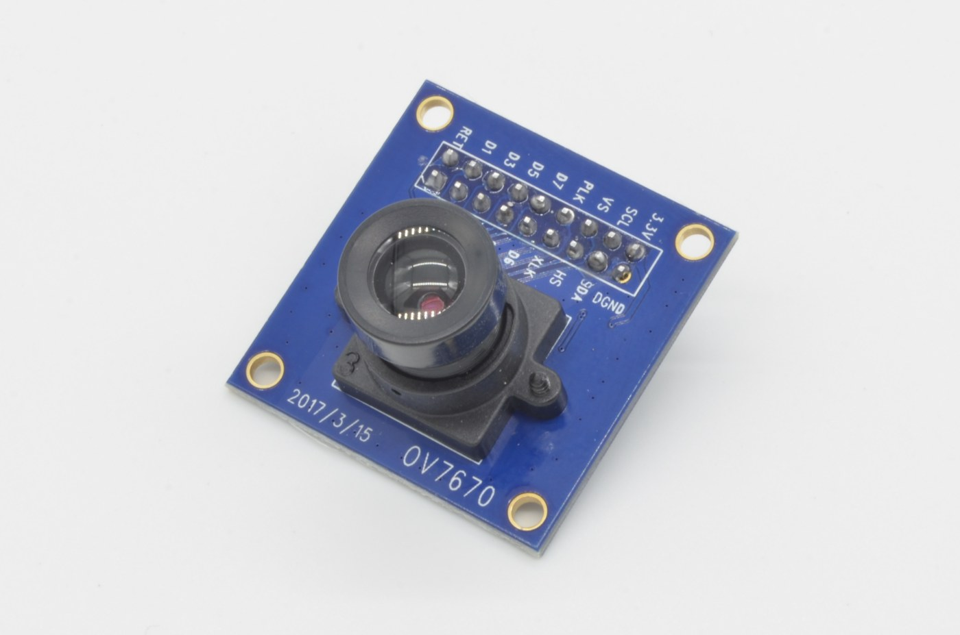
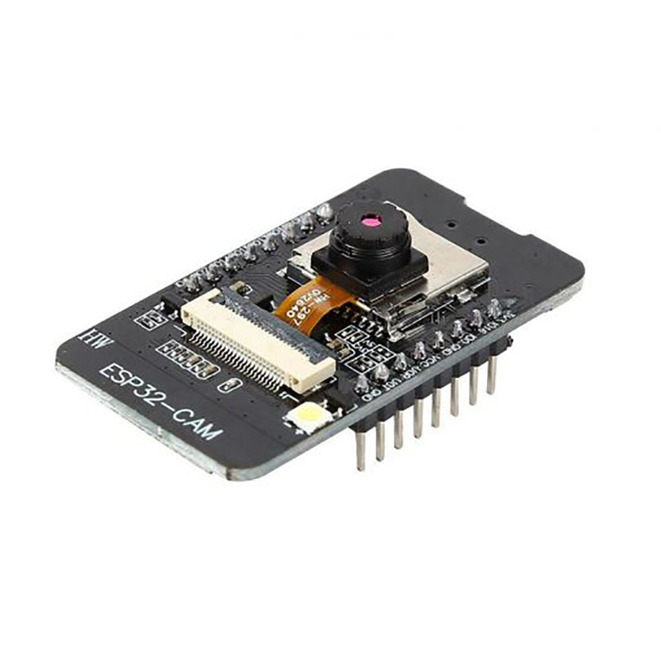
Camera
Started with cardboard box placed on frame named camera.
Second iteration was using Arduino Uno and DAOKI OV7670 Camera Module.
Third iteration we decided to use ESP32 cam because of space limitations and Wi-Fi connectivity.
Fourth iteration was ESP32 cam mounted on pan-tilt arm.

Slide 13
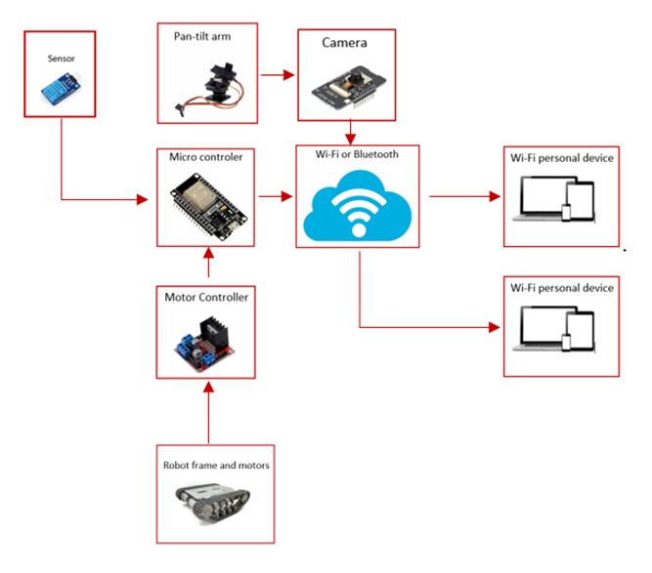
Final Project Design
Lighting system remained unchanged.
Removed PS4 controller.
Added a personal device.
We used ESP-32 cam so we routed the camera arm control through the cam.
Unable to finish thermal camera sensor.

Slide 14
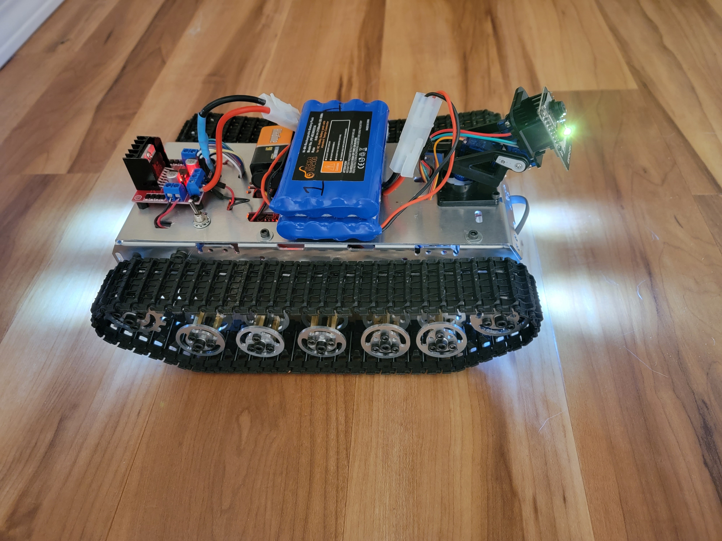
Final Project Prototype
We feel we have reached the goal we set out to accomplish.
Each sprint we improved on each of our subsystems incrementally.
After subsystems where finished we added them to the robot frame.

Slide 15
Unfinished and Future Steps
Finish implementing thermal sensor.
Bright paint and labeling.
Upgrade lighting system.
Upgrade DHT-11 sensor and camera.
Upgrade motors and tracks.
Implement a communication system.
Try to reduce size and energy consumption.
Create an app to control and monitor everything from one screen.
Implement heat shielding.

Slide 16
Final Conclusion
Our team learned a lot of new skills.
Proud of what we created.
We achieved the majority of what we set out to achieve.
We where not able to implement the thermal sensor because we were sent a dead board and the replacement did not arrive in time. We did replace this with the ESP-32 cam.
Wish we had more time to work on the project. To achieve all of our goals.

Slide 17
Thank You! Any Questions or Comments?

